Slide 1
Welcome
Sugar and Salt in our Food and Drink

Slide 2
Ice-breaker – Change 4 Life quiz

Slide 3
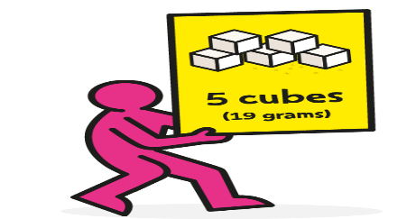
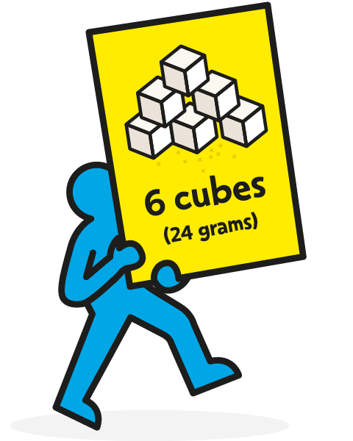
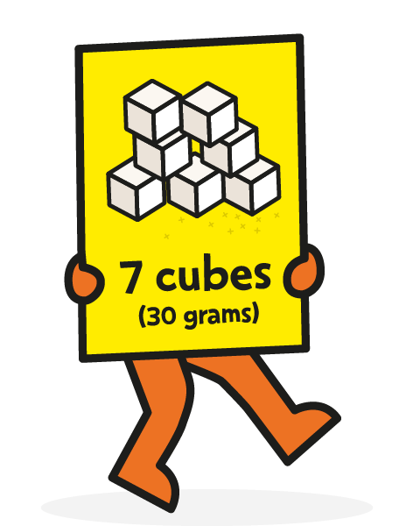
How much refined sugar should we eat/drink?
4-6 years 5 cubes / 19g max
7-10 years 6 cubes / 24g max
11 years+ 7 cubes / 30g max

Slide 4
Change 4 Life – our Pupil Food Champions
Most of our added sugars come from the following:-
Drinks
Buns, cakes, pastries, biscuits
Cereals
Yogurts
Sweets
Chocolate
Ice-cream
Sauces/Condiments

Slide 5
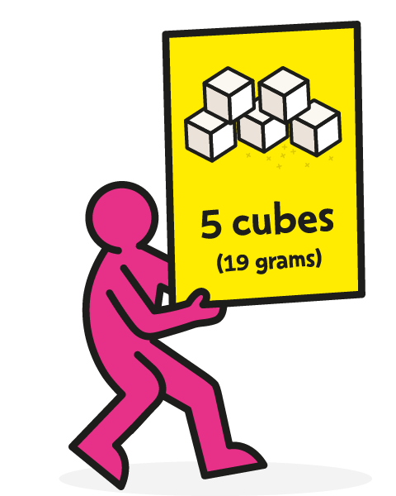
Drinks display
Remember how much sugar we should be having per day?

Slide 6
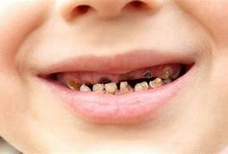
Effect of having too much sugar
Too much sugar can lead to the build up of harmful fat on our insides.
This fat sits around our vital organs and can cause weight gain and serious illnesses when we get older, such as heart disease, type 2 diabetes and some cancers.
Having too much sugar can also cause tooth decay.

Slide 7

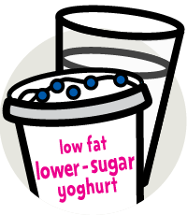
What sugars shouldn’t we worry about?
Sugar in milk and plain yogurt is OK – this isn’t added sugar.
Sugar in fruits and vegetables – this isn’t added sugar. Fruit and vegetables are part of our 5 a day and are a great source of fibre.
Don’t forget, if we increase our fibre we need to increase our fluid intake.
If we eat dried fruits or drink smoothies try and keep these to mealtimes to protect our teeth.

Slide 8
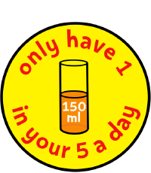
Fruit juice and smoothies
Fruit juice and smoothies count towards our 5 a day but are sugary so we should limit our amount to 150ml a day.

Slide 9
Sugar and artificial sweeteners in food and drink
No added sugar squash can contain non-plant based sweetener – possible links to some cancers
Cheap honey is the same as pure fructose
Stevia is a plant based sweetener
Ribena; Robinson Barley; Hi Juice

Slide 10
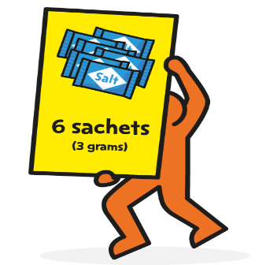
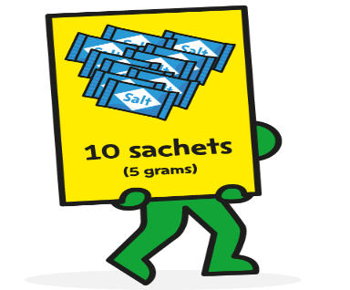
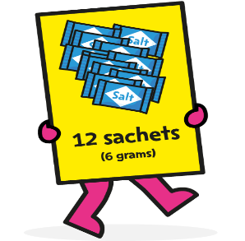
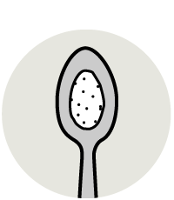
How much salt should we eat?
4-6 years 6 sachets/3 grams
7-10 years 10 sachets/5 grams
11+ years 12 sachets/6 grams
6 grams is less than a teaspoon!

Slide 11
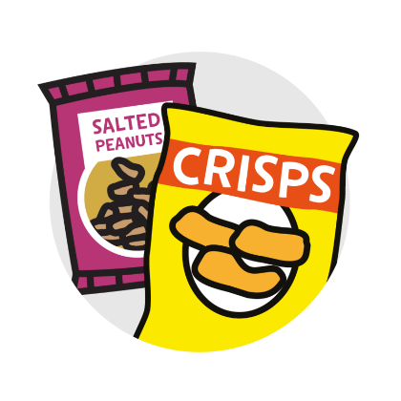




Hidden salt and its effects
Watch out for salt in sausages; bacon; ham; pastries; pizza; cheese; crisps; salted nuts; gravy; brown sauce; soy sauce; mustard and ketchup.
Too much salt can lead to high blood pressure and heart disease in later life.

Slide 12
What we can use instead of salt?
Herbs
Garlic

Slide 13
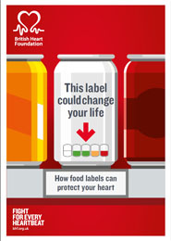

Slide 14
Healthy snack swaps
Tasting time!

Slide 15
Ideas for further snack swaps?
Change 4 Life – meal and snack recipes on a budget
Children’s Food Trust – ideas for packed lunches
BBC Good Food recipes – tasty recipes that may need adapting
Go Green! (check g per 100 g)

