Slide 1

Welcome
to our Food Champion Workshop
focusing on Fussy Eaters

Slide 2
What is the Food Champion Programme?
This scheme aims to improve the diet of our pupils, their knowledge of where food comes from, their cooking skills and their food choices.

Slide 3
Fussy Eaters
Natural for us as parents and carers to worry about whether our children are eating enough and that they are eating the ‘right’ foods.
The trick is to not to worry about what they are eating at each meal but want they are eating, and drinking, throughout the day.
This workshop will look at the Eatwell Guide so we, and they know, our food groups; tips for introducing new foods; tips for relaxed mealtimes; what we have learnt in school encourages fussy eaters to try new things and incentives/rewards.
These are generic messages and ideas to support fussy eaters and are not specifically related to any medical condition or emotional eating disorders.

Slide 4

What foods do you dislike?
Notes:
What is a fussy eater?
Someone who does not eat a variety of foods. This usually results in poor nutrition and can lead to nutrient deficiencies and health problems. It’s important to distinguish between a fussy eater and someone who just doesn’t like a select few foods which won’t have an impact on the balance of nutrients they consume.
We all have our own likes and dislikes and we may not necessarily know why we dislike certain foods. Sometimes we find ourselves pulling faces or turning our noses up at foods we dislike and many of us may have a strong feeling of disgust about a particular food.
Before we explore the potential causes of food likes and dislikes and fussy eating we want to find out what your personal dislikes are. For the next minute introduce yourself to the person next to you and have a chat about a food you really don’t like and possible reasons for this food dislike. It’s fine if you have no idea why you don’t like this particular food. We will then just have a quick round robin of your name, where you work and your dislikes.
Start or end the feedback off by presenting own dislike and potential cause.

Slide 5
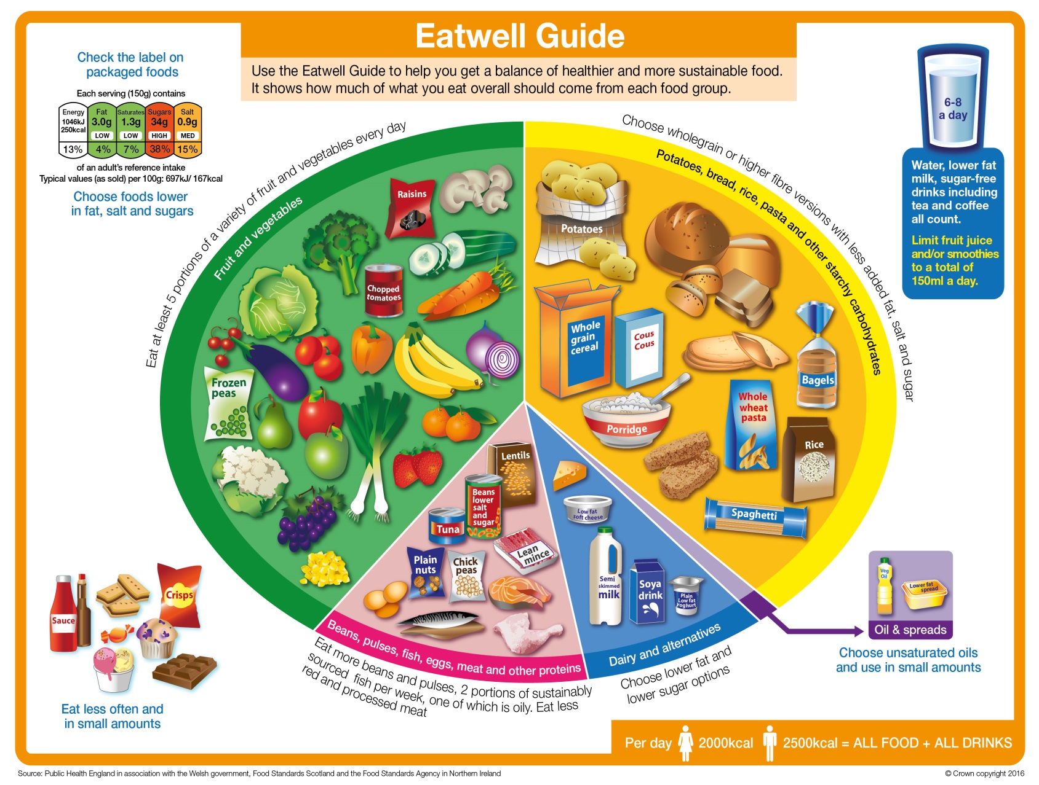
The Eatwell Guide - We need to eat a balance and variety of foods from these groups:

Slide 6






















Fruit & Vegetables
Eat plenty from this group
How much is recommended a day for positive health benefits?
Notes:
6
Which foods do you think are included in this section of the Eatwell guide?
Apples; Carrots; Bananas; Grapes; Peppers; Broccoli; Cauliflower; Orange juice;
Mushrooms; Beetroot; Strawberries; half an avocado, half grapefruit, sweet potato
How much is recommended to eat for health?
5 ways to get ‘5 a day’ - Fresh; Tinned; Juice (100% pure juice; 150ml); Dried; Frozen
Third of foods recommended
Most of us need to eat more
A portion - 80g; A handful
400g/day
Healthy eating tips
Little calorie content; very low fat & high in fibre
Have sugary sticky items (e.g. dried apricots, raisins, fruit juice) with meals (not for snacks) for good oral health
‘Eat a rainbow’
What nutrients are high in this section of the eatwell guide?
Include a variety – different combinations of vitamins, minerals & fibre
Vitamin C high in some fruit & vegetables; Help iron absorption
Potatoes & cassava don’t count because they are a starchy food and normally form the basis of a meal instead of rice/pasta
Benefits to health
Less risk of some cancers such as bowel

Slide 7
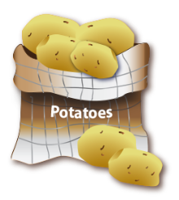




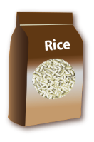

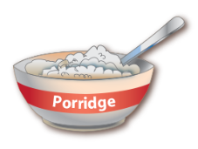


Potatoes, bread, rice, pasta and other starchy carbohydrates
Eat plenty from this group
Base of every main meal
Choose a mixture of white
& wholegrain for early
Years and wholegrains for 5y +
Notes:
7
Which foods do you think are included in this section of the Eatwell Guide?
Cous cous; Noodles; Quinoa; Oats; Crumpets; bagels; lentils; beans
How much is recommended to eat for health?
Third of the food we eat
Healthy eating Tips
Less than half calories of fatty foods
Reduce foods high in fat within meal – Not Jacket potato with butter;
Creamy sauces on pasta; Oily dressing on potato salad
What nutrients are high in this section of the Eatwell guide?
Starchy foods are a good source of energy - a form of carbohydrate
Contain fibre (soluble and insoluble) & B vitamins
B vitamins help release energy from foods

Slide 8
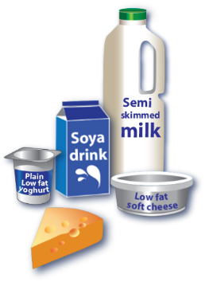
Dairy and alternatives
Eat moderate amounts
Provide essential minerals for bone and teeth
Notes:
8
Which foods do you think are included in this section of the Eatwell Guide?
Milk; Cheese; Yoghurt; Cottage cheese; Soft cheese;
Soya milk fortified with calcium; Tofu; Fromage frais; Quark
(Vegan: fortified soya, rice & oat drink, calcium set tofu, sesame seeds & tahini, pulses, brown & white uk bread, raisins, prunes, apricots)
How much is recommended to eat for health?
Eat some dairy and alternatives.
Healthy eating Tips
If sourced from animals the fat is saturated
Choose lower-fat varieties – Cottage cheese; Semi-skimmed milk
Some lower-fat products high in sugar
Cost comparisons with low-fat products v’s normal products. E.g. Plain yoghurt & low-fat yoghurt
Strong tasting cheese; grate cheese so use less
Recipe idea: Grated cheese & carrot in a sandwich
Small changes can make a big difference. E.g. full-fat v’s semi-skimmed (1.8% fat) v’s 1% milk
What nutrients are high in this section of the eatwell guide?
Calcium - needed for development and maintenance of healthy bones (45% of adult skeleton is laid down in adolescence.
Protein - needed for growth and repair; also a source of energy
Vitamin A, in whole milk products - for growth; development and eyesight
Vitamin D, in dairy - for bone growth and strength (rickets and osteoporosis)

Slide 9









Beans, pulses, fish, eggs, meat and other proteins
Eat moderate amounts
Provide nutrients essential for growth
Eat at least 2 portions of fish a week – 1 being oily
Notes:
9
Which foods do you think are included in this section of the Eatwell guide?
Meat – Chicken; Beef; Ham, Lamb
Meat products – Bacon; Salami; Sausages; Beef burgers & Pate
Fish – Frozen; Fresh; Smoked & canned fish; Fish fingers & fish cakes
Eggs
Non-dairy sources of protein including nuts; Tofu; TVP; Mycoprotein (quorn)
Beans; Red kidney Bean’s; Canned beans & pulses; Lentils & split peas
Nuts, seeds
How much should we aim to eat?
Eat moderate amounts
Pack of cards is one portion; 50-100g lean meat, poultry or fish
3 tbsp baked beans; 2 thin slices of lean cold meat
No maximum amount for egg consumption/week – choose variety of foods from this section
Some meat products contain high amounts of fat, especially high in saturated if from animal origin
Try and use lower fat versions
Healthy adults aim to eat two portions of fish a week, one being oily fish. E.g. salmon; mackerel. Canned tuna not oily.
Children should eat at least two portions (a portion is around 140g) of fish per week, one of which should be an oily fish such as mackerel, salmon or sardines. Fish provides protein and several vitamins and minerals, and oily fish provides the long chain omega-3 fatty acids. There is a recommended maximum intake of oily fish: for boys no more than four portions of oily fish a week, and for girls no more than two portions of oily fish a week. The lower recommendation for girls is because substances found in oily fish, such as dioxins, can accumulate in the body. High levels of these may be detrimental in later life to an unborn baby. Large predator fish such as shark, swordfish and marlin can contain relatively high levels of mercury as this accumulates up the food chain. Mercury can affect the developing nervous system of young children, so these fish should not be given to children.
NDNS data 2014: oily fish: average consumption of oily fish was well below the recommended one portion (140g) per week in all age groups.
Healthy Eating tips
Choose lean meat. If you eat more than 90g red / processed meat a day, reduce this to 75g.
Meat products such as burgers can be high in salt also; Homemade can be healthier
Grill; Roast; Steam - instead of frying
Poach or boil eggs
Before serving can put on kitchen paper to soak up the fat
Q: Put your hand up if you’ve ever added lentils to any dishes to make the meals go further?
Vegetables to dishes rather than extra meat. E.g. Can make corn beef hash with baked beans;
Adding lentils and pulses doesn’t have to be tasteless. E.g. Puy lentils, sausages, onion, flavoured with herbs and spices served with mashed potato and it’s so tasty!
What nutrients are high in this section of the Eatwell guide?
Protein - needed for growth and repair; also a source of energy
All amino acids from variety of protein foods
The best source of iron is red meat. According to NDNS data published in 2014: 46% of girls and 23% of women had low iron intakes.
Haem iron from meats more easily absorbed than from plants
Avoid drinking tea – prevents iron absorption
Vegan
Good sources of iron for vegans are: pulses, wholemeal bread and flour, breakfast cereals fortified with iron, dark-green leafy veg e.g. watercress, broccoli, spring greens and okra, nuts, dried fruits e.g. apricots, prunes and figs
Plant sources of omega 3 (per 100g) include:
linseed (flaxseed) oil: 53.3g
walnut oil:11.5g
rapeseed oil: 9.6g
soya bean oil: 7.3g
Also, soya based foods such as tofu and walnuts.
Evidence suggests that vegetarian sources of omega 3 fatty acids may not have the same benefits in reducing risk of heart disease as those in oily fish.

Slide 10

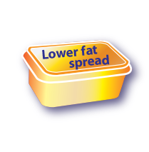
Oils and spreads
Although some fat in the diet is essential, generally we are eating too much saturated fat and need to reduce our consumption.
Unsaturated fats are healthier fats that are usually from plant sources and in liquid form as oil, for example vegetable oil, rapeseed oil and olive oil.
Swapping to unsaturated fats will help to reduce cholesterol in the blood, therefore it is important to get most of our fat from unsaturated oils.
Choosing lower fat spreads, as opposed to butter, is a good way to reduce your saturated fat intake.
Remember that all types of fat are high in energy and should be limited in the diet.
Notes:
10
Which foods do you think are included in this section of the Eatwell guide?
How much should we aim to eat?
Most of us should eat less fats & sugars - It’s the frequency and amounts of these foods which can lead to gaining too much weight
Fats contain lots of calories
Sugars contain just energy & no nutrients
Healthy eating Tips
To enjoy food have a little, not to completely avoid
Dilute drinks gradually; cakes swap to more starchy food e.g. currant bun; add a banana on toast or cereal instead of jam/honey
What nutrients are high in this section of the Eatwell guide?
Q: Margarine has this much fat. How much fat has reduced margarine? Put your hands up if you think……????
Flora Original = 45g; Flora Light = 30g (Source - Tesco online 2012)
FSA law = ??

Slide 11
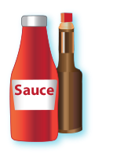






Includes chocolate, cakes, biscuits, full-sugar soft drinks, butter and ice-cream.
These foods are not needed in the diet. If they are included, have infrequently and in small amounts.
If you consume these foods and drinks often, try to limit their consumption so you have them less often and in smaller amounts. Food and drinks high in fat and sugar contain lots of energy, particularly when you have large servings.
Check the label and avoid foods which are
high in fat, salt and sugar!
Foods high in fat, salt and sugars
Notes:
11
Which foods do you think wouldn’t me included on the eatwell guide and aren’t needed in the diet?
Fats:
Margarine; Butter; Spreading fats and Reduced Fat Spreads
Cooking oils & oil-based salad dressings
Mayonnaise; Cream
Chocolate; Crisps & biscuits
Pastries; Cake; Puddings & Ice-cream
Rich sauces & gravies (using drained off fat)
Sugars:
Fizzy drinks (not diet drinks)
Energy drinks
Sweets
Jam; Sugar; Honey & Alternatives
Cakes; Puddings; Biscuits; Pastries & Ice-cream
How much should we aim to eat?
Most of us should eat less fats & sugars - It’s the frequency and amounts of these foods which can lead to gaining too much weight
Fats contain lots of calories
Sugars contain just energy & no nutrients
Healthy eating Tips
To enjoy food have a little, not to completely avoid
Dilute drinks gradually; cakes swap to more starchy food e.g. currant bun; add a banana on toast or cereal instead of jam/honey
What nutrients are high in these foods and drinks?
Technical: some reduced fat products still are high in fat, e.g. crisps and mayonnaise.

Slide 12
Sugar guidelines
4-6 years 5 cubes / 19g max
7-10 years 6 cubes / 24g max
11 years+ 7 cubes / 30g max
Salt guidelines
4-6 years 6 sachets/3 grams
7-10 years 10 sachets/5 grams
11+ years 12 sachets/6 grams
6 grams is less than a teaspoon!

Slide 13
Taste test
Here are a few tasty samples from our school menu:-
Pizza
Chocolate Cake
Chilli
Noodles
Water!
Can you guess the ingredients? What foods groups are covered from our Eatwell Guide?

Slide 14
Why are some of us ‘fussy eaters’?
Our food preferences can be:-
Innate
Genetic
Environmental
and can impact on our weight and health. Our children (aged 5+) find it difficult to control their appetite so are particularly affected by environmental influences.

Slide 15
Environmental
Family
Social
Food availability eg. fast food outlets
Societal eg. the norms of our society and culture; media

Slide 16
Question
How many times does a child need to try a food before they like it?

Slide 17
Answer
12 – 15 times!

Slide 18
Before trying the foods
Repeated exposure
Seeing it on their plate and all the family member’s plates
Or seeing it is available to serve themselves on the table (think of how they see foods available at school and ‘Eat a Rainbow’ game)
Praise for:
having the foods on their plate
smelling the new foods
licking the new foods

Slide 19
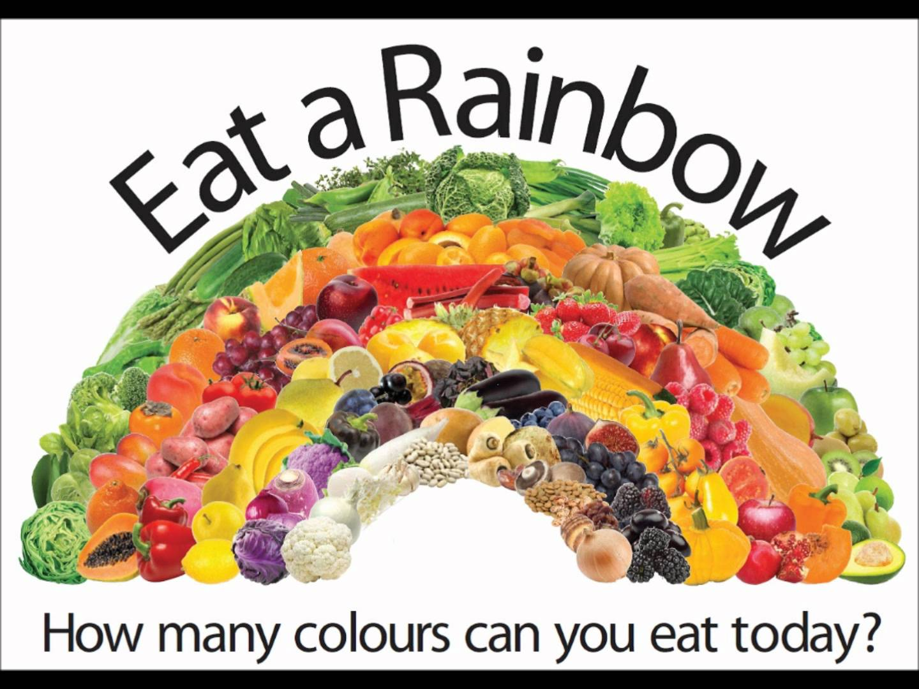
Notes:
This is how we encourage children in school, as well as displaying the Eatwell Guide.

Slide 20
Quick and easy ideas
Family members model trying new foods
Give small portions
Don’t force children to try the foods, just encourage them to leave it on their plate
Be patient, some of us are slow eaters!
Make mealtimes relaxed and not just about eating, eg. chat about our day
Offer variety, eg. fruit already cut up and easily accessible; carrots can be served cooked or uncooked (grated is popular)

Slide 21
More ideas
Plan meals together
Cook together eg. CBBC – ‘I can cook’; make chicken nuggets
Reward trying new foods with non-food related activities, eg. trip to the park; family activity ideas from Change 4 Life
Invite friends for tea who enjoy a variety of foods (children often eat things in school because their friends are eating it, eg. watermelon lollies)
Limit snacks to two per day (our healthy snack swap workshop is on our website)
Do not leave mealtimes to when the children are very hungry or tired

Slide 22
Reminder about healthy hydration
Water
6-8 glasses per day
Sugar content in drinks

Slide 23
Questions and Vouchers
Evaluation

